Slide 1

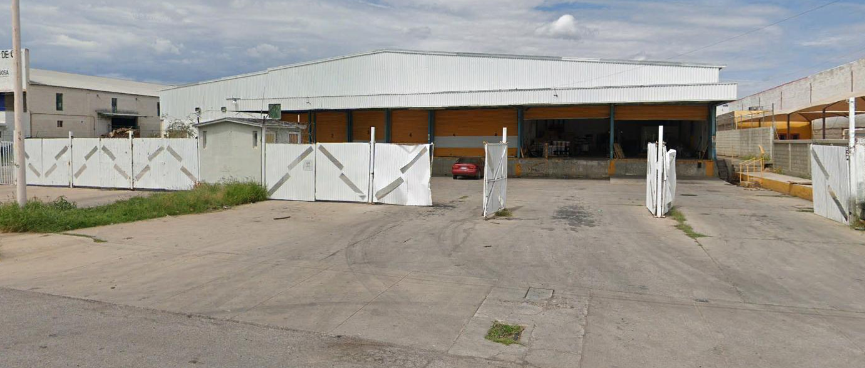
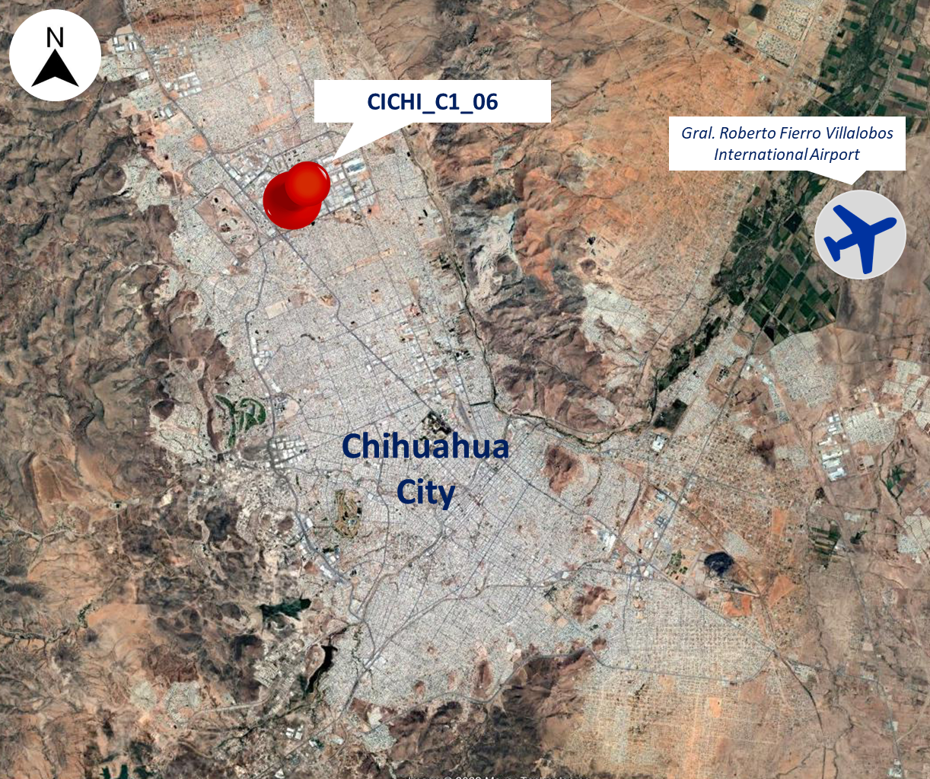
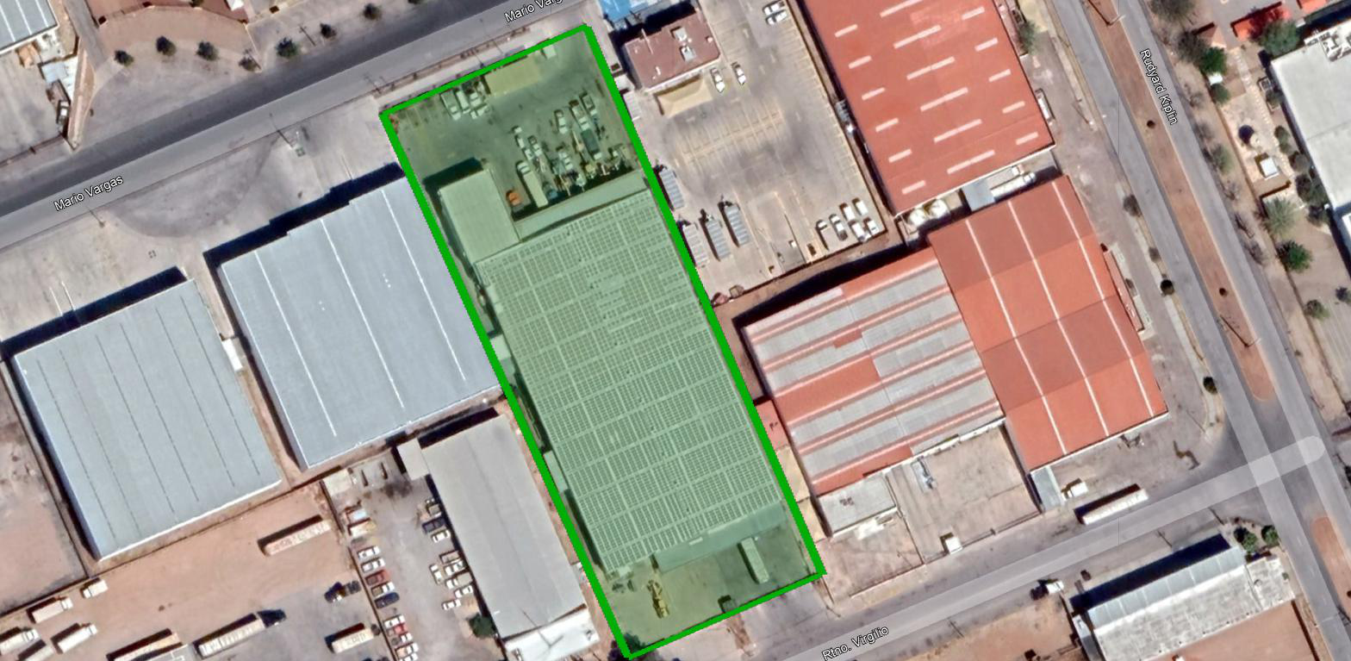
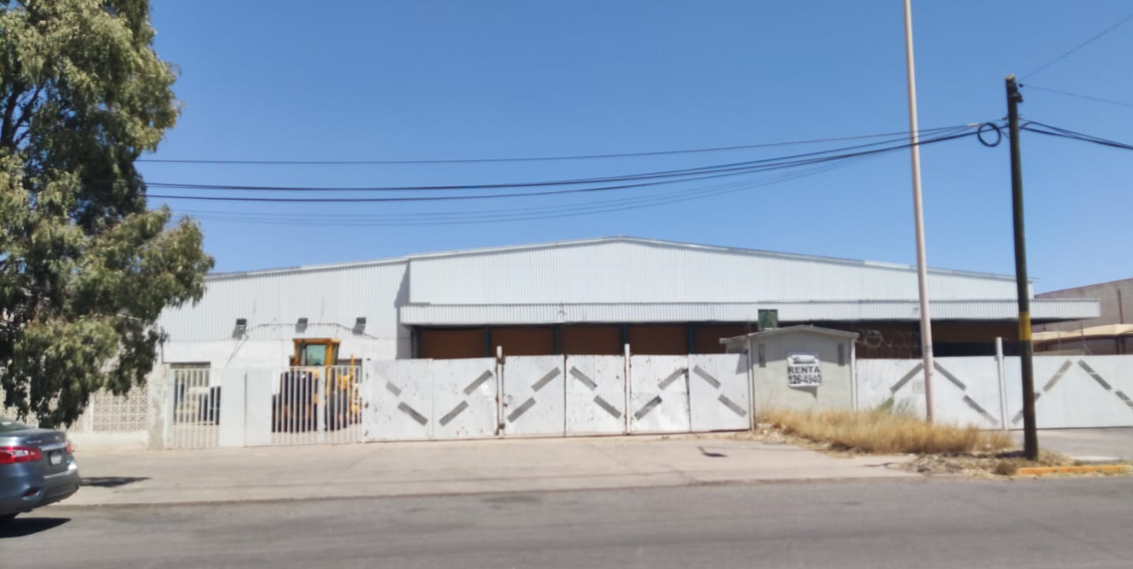
CICHI_C1_06
Industrial Space: 36,230 SF (3,366 m²)
Complejo Industrial Chihuahua | Chihuahua City | Mexico
HIGHLIGHTS
Located inside one of the most important industrial parks in the city.
With access to the main roads of the city.
In close proximity to commercial and residential areas.
Building Specifications
Building area | 36,230 sf (3,366 m²)
Office | Included
Land area | 78,706 sf (7,312 m²)
Docks | 10
Car parking | 10
Retorno Virgilio 100, Complejo Industrial Chihuahua
Chihuahua, Chihuahua, C.P 31136
AERIAL VIEW

